Slide 1
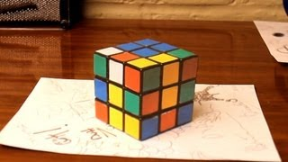
Anamorphic Illusions
A quick demonstration:
Owen Lin, Yilin Ni

Slide 2
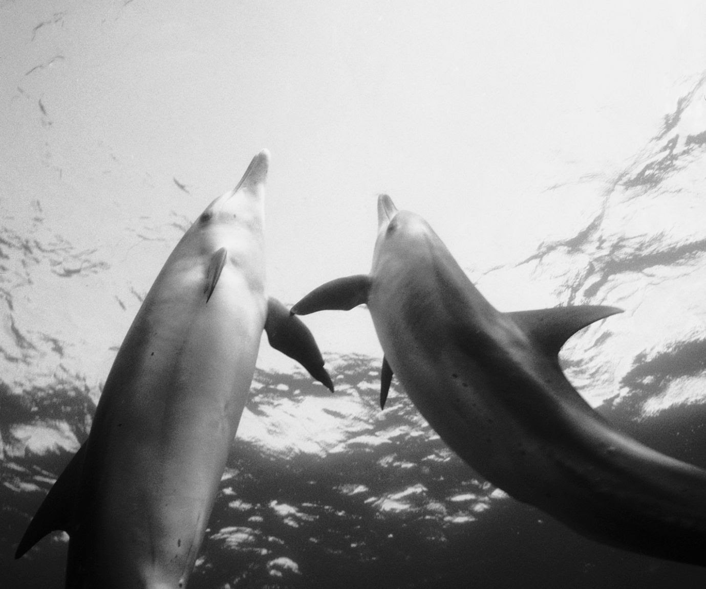
INTRODUCTION
We want to utilize warping techniques to create an effect that is similar to anamorphic illusion. Specifically, we have a moving camera, BUT under the assumption of plain surface, a homography can still be applied for transformation with appropriate mask.

Slide 3
TABLE OF CONTENTS
1
Corner Detection with ANMS
2
⭐Automatic Masks Segmentation with SAM
3
⭐SIFT Feature Descriptor
4
Feature Matching and RANSAC
5
⭐Warping and Distance Blending

Slide 4
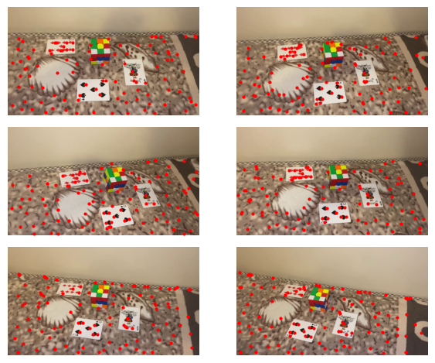
Corner Detection with ANMS
Standard Harris Corner Detection
Use Adaptive-Nonmaxial Suppression (ANMS) to reduce the number of corners while preserving their spatial distribution
ANMS ranks corners by its “distance to the nearest stronger points” and retain the top n points

Slide 5
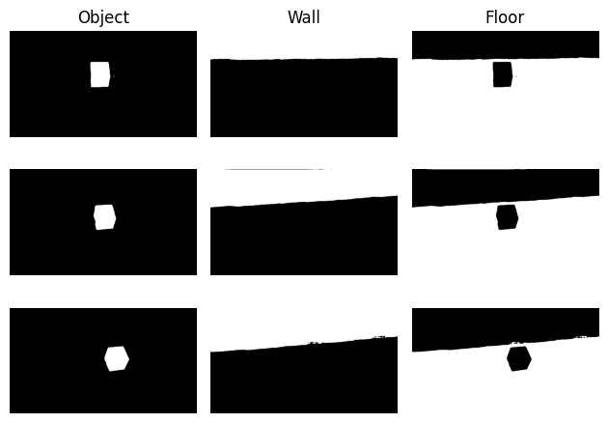
Mask Segmentation with SAM
Segment Anything Model (SAM) is an advanced Segmentation Model developed by Meta
The AutomaticMaskGenerator provides masks without labeling - Out of time to implement semantic segmentation
Instead, we use bounding box to obtain the mask
Notes:
from segment_anything import sam_model_registry, SamAutomaticMaskGenerator, SamPredictor

Slide 6
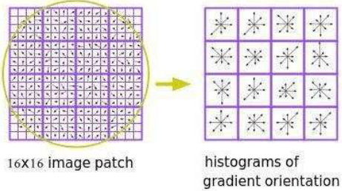
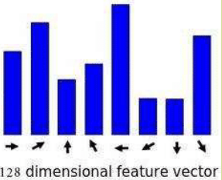
SIFT Feature Descriptor
Scale Invariant Feature Transform (SIFT) describes a local feature in a rotation invariant way
Utilize gradient field around a feature. For each of the image patch make a histogram of gradient and stack the 16 patches

Slide 7
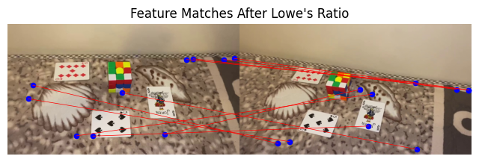
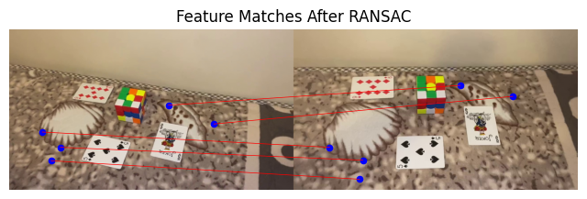
Feature Matching and RANSAC
Feature Matching with Lowe’s Ratio = 0.8 (tested empirically)
Use Random Sample Consensus (RANSAC) to further reduce the matching features
One success example is provide on the right hand side. Note that there were very few good corresponding points

Slide 8
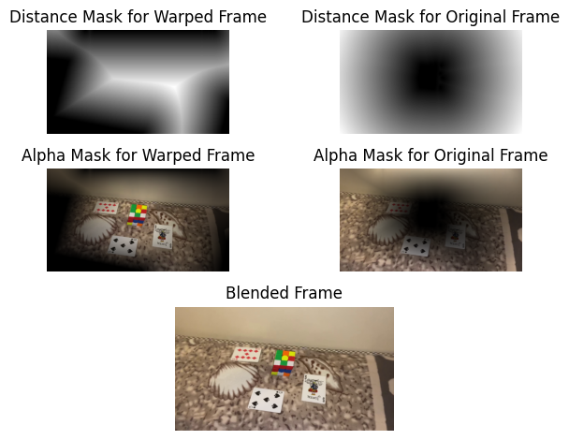
Warping and Distance Blending
For warped frames, we use inverse warping and interpolate the color value from the original frame
The warping only applies to the ground mask - including the cube
For distance mask on original frame, choose the cube as the bounding mask
a1 = w1 / (w1 + w2)
a2 = w2/ (w1 + w2)

Slide 9

Project Demonstration

Slide 10
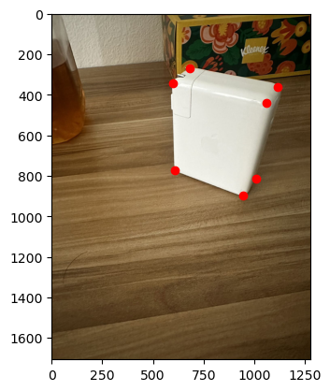
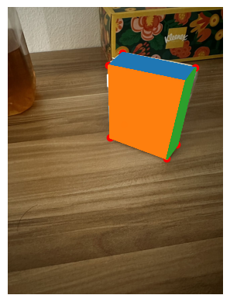
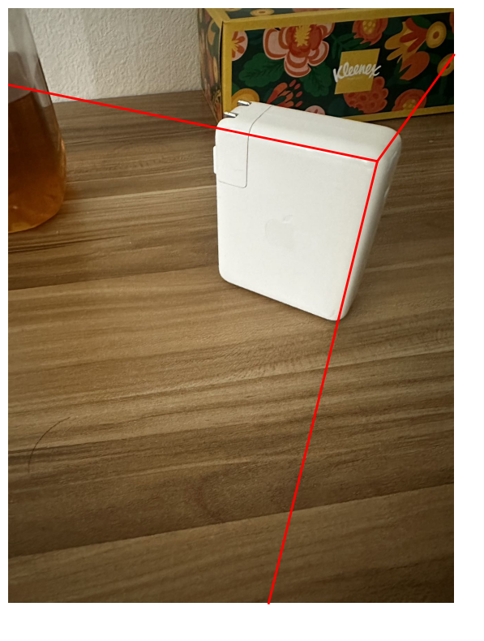
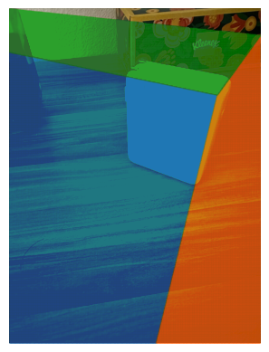


Slide 11
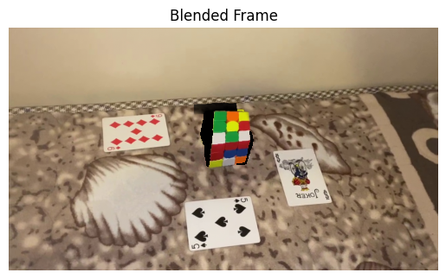
Summary and Failed Attempt
Tried to use the forward face of the cube to find homography
The expected result would be a cube sheet that is perpendicular to the ground.
Fill the background (once occupied by the 3D volume of the cube) with texture synthesis
Problem: Can’t find a mask for the face of the cube - hard to make it video consistent

Slide 12
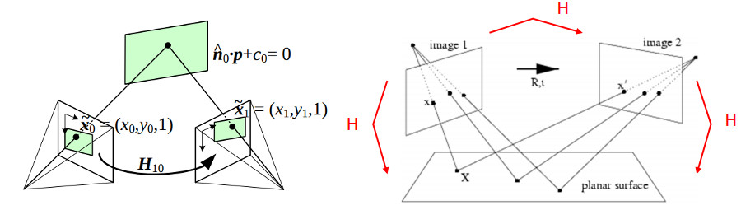

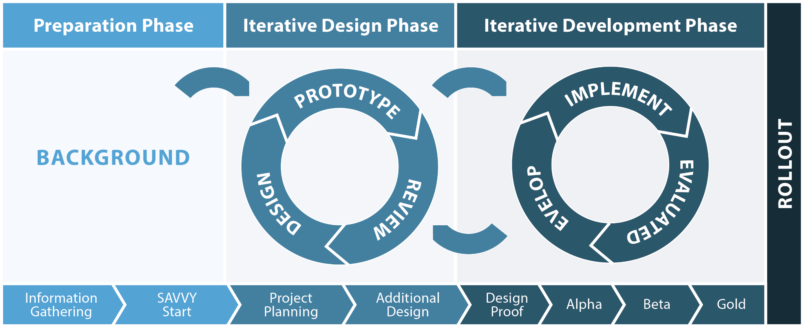
THANK YOU

